Slide 1


Artificial Intelligence Project Presentation
Student Score Prediction Using AI
Course:
Artificial Intelligence (CAN703)
by:
Vaibhav Bisht (1000019863)
Faculty Guide:
Ms. Shruti Singh
SCHOOL OF COMPUTING
DIT UNIVERSITY, DEHRADUN
November 2025

Slide 2

Problem Statement
Educational institutions need proactive tools to identify at-risk students early and optimize learning outcomes. Traditional methods rely on intuition, but AI offers data-driven insights.
By analyzing patterns in student behavior and performance, we can intervene before failure occurs, personalizing support and improving graduation rates.

Slide 3



Project Objectives
Accurate Prediction
Model Comparison
Performance Visualization
Build models that reliably forecast student exam scores based on multiple behavioral and academic factors
Evaluate Linear Regression, Random Forest, and Neural Networks to identify optimal approach
Present R² scores and prediction accuracy through clear, actionable visualizations

Slide 4
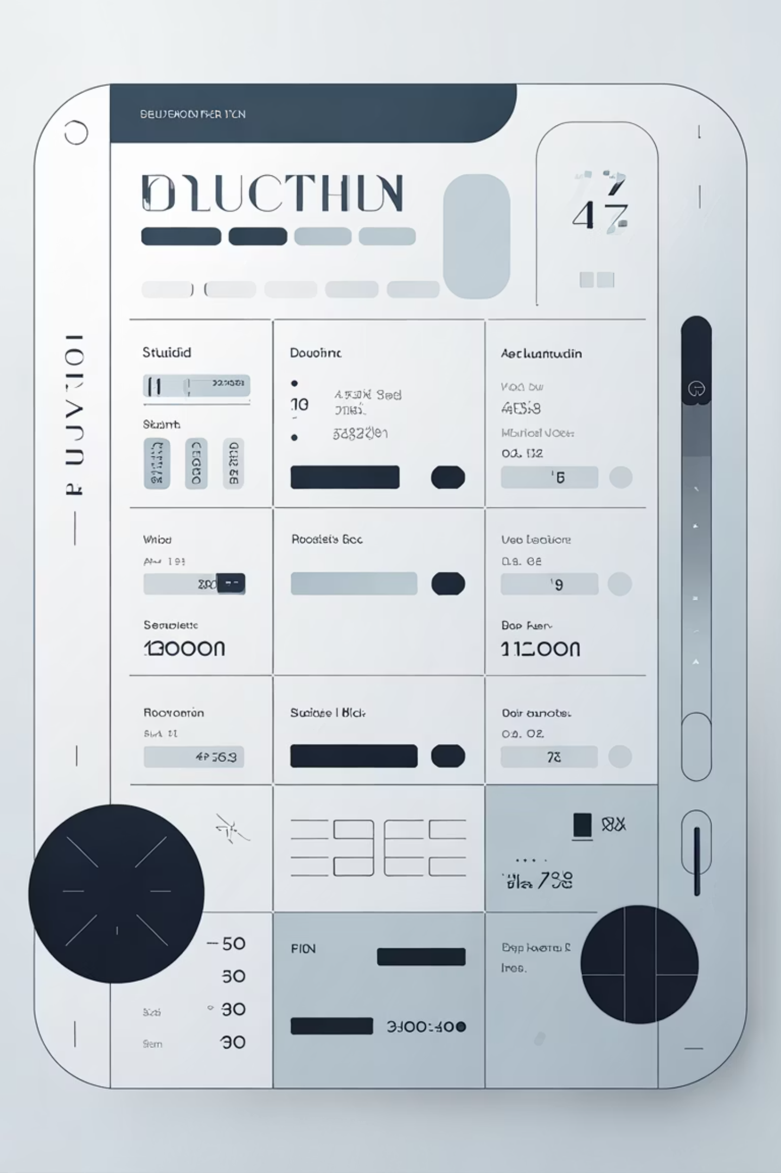
Dataset Overview
Key Features Analyzed
Study Hours: Weekly time dedicated to coursework
Target Variable
Attendance Rate: Percentage of classes attended
Final Exam Score: The predicted outcome ranging from 0-100, representing student performance on the comprehensive examination
Previous Scores: Historical academic performance
Assignment Completion: Homework submission rates
Extracurricular Activities: Time spent on non-academic activities

Slide 5




Data Preprocessing Pipeline
Missing Values
Normalization
Identified and imputed missing data using median/mode strategies to ensure dataset completeness
Scaled features to 0-1 range using MinMaxScaler for consistent model input
Train-Test Split
Feature Selection
Divided data 80/20 to train models and validate performance on unseen data
Removed low-correlation features to reduce noise and improve model efficiency

Slide 6
Machine Learning Models Deployed
Linear Regression
Random Forest
Neural Network
A foundational statistical approach that models the relationship between features and scores using a linear equation. Fast and interpretable, ideal for baseline comparison.
An ensemble learning method that constructs multiple decision trees and averages their predictions. Excellent for capturing non-linear relationships and feature interactions.
A deep learning architecture with multiple layers that learns complex patterns through backpropagation. Powerful for sophisticated, non-linear modeling tasks.

Slide 7
Challenges
Data Preprocessing
Dropping irrelevant columns without affecting model performance.
Filling missing values only for numeric columns.
Encoding categorical variables correctly without introducing bias.
Model Training
Random Forest may overfit if the dataset is small or imbalanced.
Linear Regression is sensitive to extremes value that reduce accuracy.
Neural networks can memorize training data, especially with small
datasets or too many layer results in overfitting conditions.

Slide 8
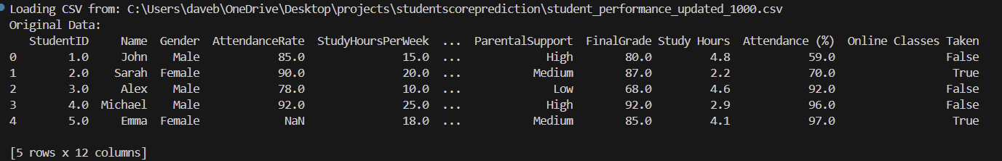
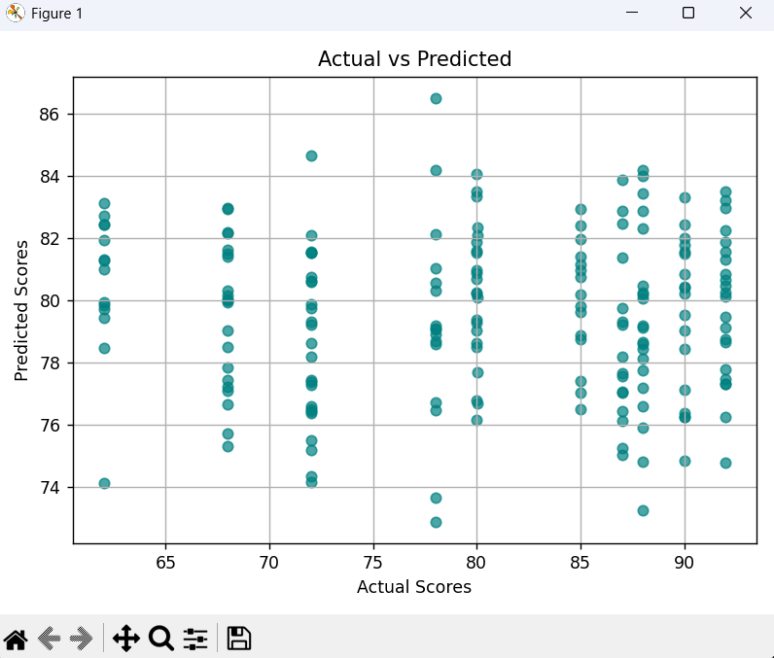
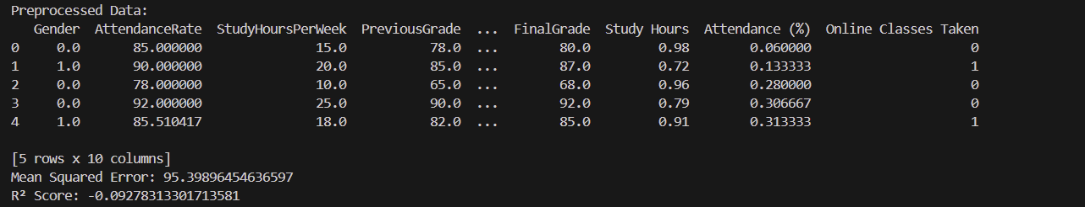
Results
Attributes of dataset before Data preprocessing
Graph of dataset
Attributes after Cleaning and Data Preprocessing

Slide 9
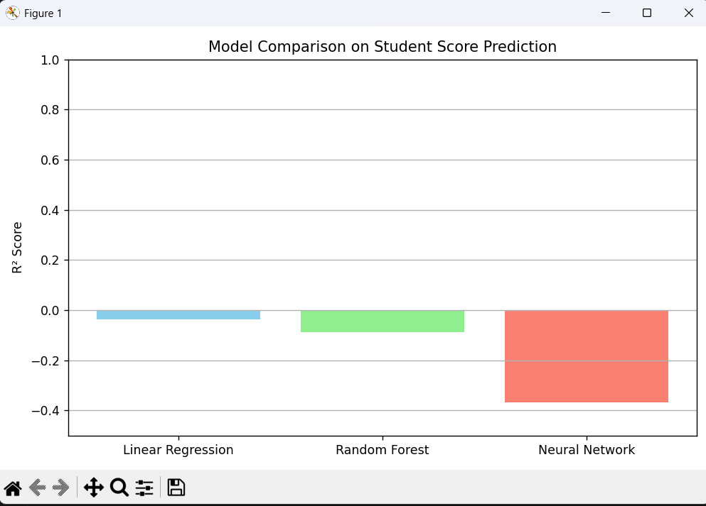
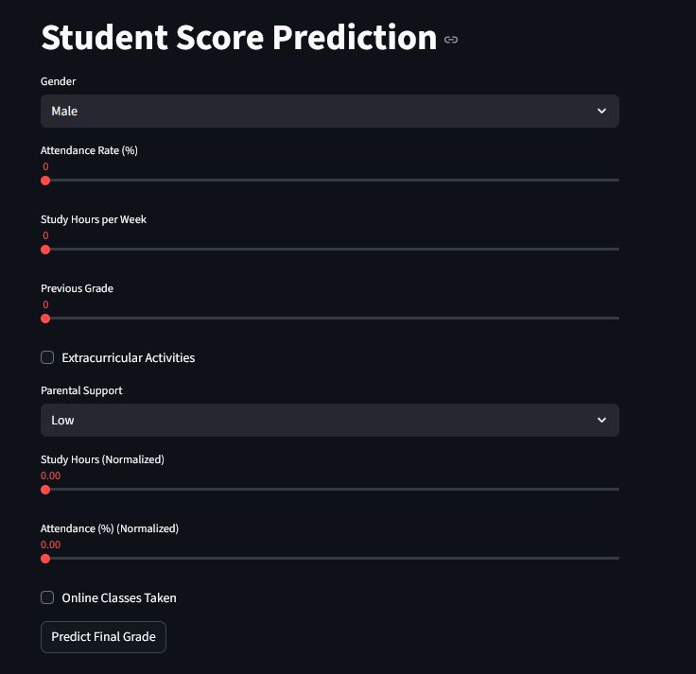
Comparison of All models performing on the same dataset
User Interface of Application

Slide 10
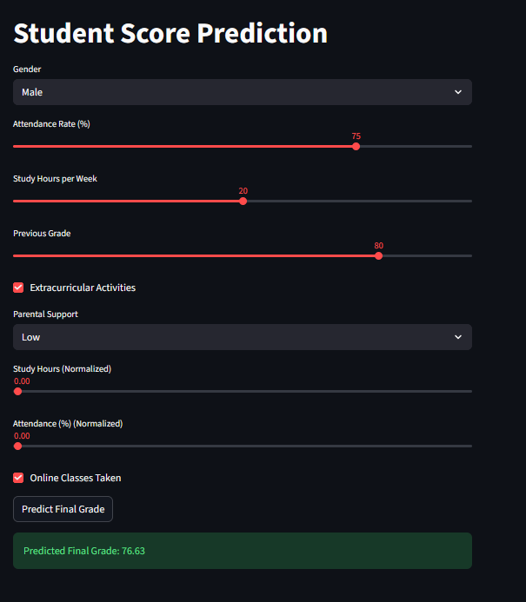
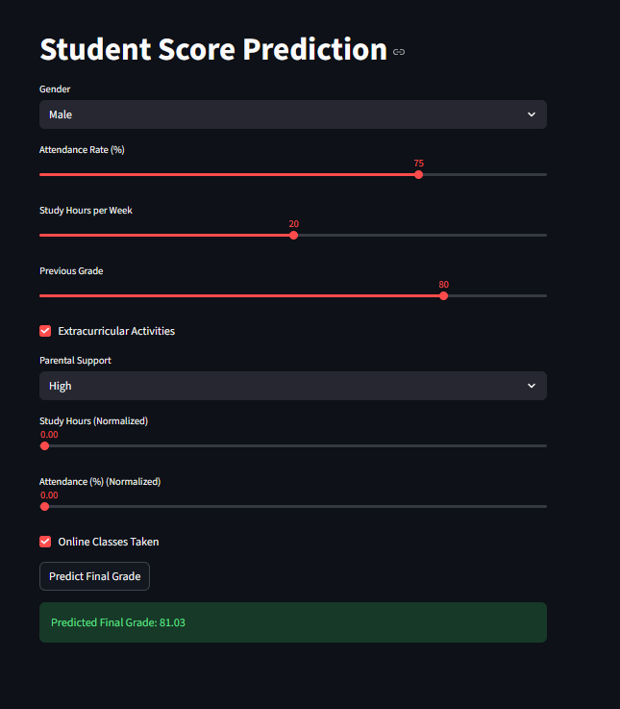
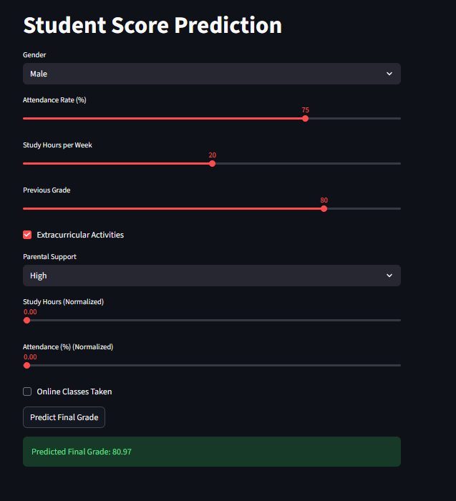
Predicted outcomes of the models on different inputs

Slide 11
Conclusion & Future Directions
Key Findings
Future Enhancements
Study habits and prior performance are critical factors
Build a personal dashboard for each students.
AI models enable early intervention for at-risk students
Deploy real-time prediction dashboard for educators
Linear Regression works better on small dataset.
Expand dataset with multi-semester longitudinal data
Random forest works better on large dataset.
Upgrade model for giving suggestion to improve marks

Slide 12
Acknowledgment
I sincerely thank:
Faculty mentors and academic advisors at DIT University for their guidance and encouragement throughout this project.
Online communities and open-source contributors for providing tutorials, datasets, and tools that enabled model comparison and visualization.
AI platforms and libraries such as VS code, Python, scikit-learn, and TensorFlow for powering the implementation of Linear Regression, Random Forest, and Neural Network models.
This project has deepened my understanding of predictive modeling and reinforced my passion for building reliable, data-driven solutions.

Slide 13
Thank You
Thank you for your time and attention!
Your interest and support are truly appreciated. This project has been a valuable learning experience in applying AI to real-world educational challenges.
Presented by: Contact: Vaibhav Bisht Email: Vabbisht219@gmail.com MCA Student, DIT University, Dehradun Phone: 8445444646

